Slide 1







Data Science Capstone Project - SpaceX
Nalli Ajay Kumar
07 July 2023

Slide 2



OUTLINE
Executive Summary
Introduction
Methodology
Results
Visualization – Charts
Dashboard
Conclusion
Appendix

Slide 3

EXECUTIVE SUMMARY
Summary of methodologies
Data collection
Data wrangling
Exploratory Data Analysis with Data Visualization
Exploratory Data Analysis with SQL
Building an interactive map with Folium
Building a Dashboard with Plotly Dash
Predictive analysis (Classification)
Summary of all results
Exploratory Data Analysis results
Interactive analytics demo in screenshots
Predictive analysis results

Slide 4

INTRODUCTION
background and context
SpaceX is the most successful company of the commercial space age, making space travel affordable. The company advertises Falcon9 rocket launches on its website, with a cost of 62 million dollars; other providers cost upward of 165 million dollars each, much of the savings is because SpaceX can reuse the first stage. Therefore, if we can determine if the first stage will land, we can determine the cost of a launch. Based on public information and machine learning models, we are going to predict if SpaceX will reuse the first stage
Problem Statement : The objective is to evaluate the viability of the new company Space Y to compete with Space X.
Questions to be answered
How do variables such as payload mass, launch site, number of flights, and orbits affect the success of the first stage landing?
Does the rate of successful landings increase over the years?
What is the best algorithm that can be used for binary classification in this case?

Slide 5

METHODOLOGY
Data collection methodology:
Using Data from SpaceX Rest API
Using Web Scrapping from Wikipedia
Performed data wrangling
Filtering the data
Dealing with missing values
Using One Hot Encoding to prepare the data to a binary classification
Performed exploratory data analysis (EDA) using visualization and SQL
Performed interactive visual analytics using Folium and Plotly Dash
Performed predictive analysis using classification models
Building, tuning the model using GridSearchCV and evaluation of classification models to ensure the best results

Slide 6
Data collection
Data collection process involved a combination of API requests from SpaceX RESTAPI and Web Scraping data from a table in SpaceX’s Wikipedia entry.
We had to use both of these data collection methods in order to get complete information about the launches for a more detailed analysis.
Data Columns are obtained by using SpaceX REST API:
FlightNumber, Date, BoosterVersion, PayloadMass, Orbit, LaunchSite, Outcome, Flights, GridFins, Reused, Legs, LandingPad, Block, ReusedCount, Serial, Longitude, Latitude
Data Columns are obtained by using Wikipedia Web Scraping:
Flight No., Launch site, Payload, PayloadMass, Orbit, Customer, LaunchOutcome, Version Booster, Booster landing, Date, Time

Slide 7
Data collection – SpaceX API
Flow chart of data collection from API Github url : click here
Requesting rocket launch data from SpaceX API
Decoding the response content using .json() and turning it into a data frame using
.json_normalize()
Requesting needed information about the launches from SpaceX API by applying custom functions
Constructing data we have obtained into a dictionary
Exporting the data to CSV
Replacing missing values of PayloadMass column with calculated .mean()for this column
Filtering the data frame to only include Falcon 9 launches
Creating a data frame from the dictionary

Slide 8
Data collection – Web scraping
Flow chart of data collection from web scraping Github url : click here
Requesting Falcon 9 launch data from Wikipedia
Creating a Beautiful Soup object from the HTML response
Extracting all column names from the HTML table header
Collecting the data by parsing HTML tables
Exporting the data to CSV
Creating a data frame from the dictionary
Constructing data we have obtained into a dictionary

Slide 9
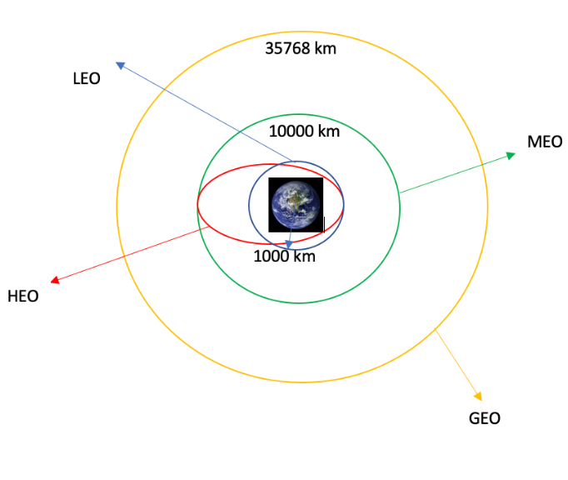
Data wrangling jupyter notebook: click here
In the data set, there are several different cases where the booster did not land successfully. Sometimes a landing was attempted but failed due to an accident; for example, True Ocean means the mission outcome was successfully landed to a specific region of the ocean while False Ocean means the mission outcome was unsuccessfully landed to a specific region of the ocean. True RTLS means the mission outcome was successfully landed to a ground pad False RTLS means the mission outcome was unsuccessfully landed to a ground pad. True ASDS means the mission outcome was successfully landed on a drone ship False ASDS means the mission outcome was unsuccessfully landed on a drone ship.
We mainly convert those outcomes into Training Labels with “1” means the booster successfully landed, “0” means it was unsuccessful
Each launch aims to a dedicated orbit, and here are some common orbits
Perform exploratory Data Analysis and determine Training Labels
Calculate the number and occurrence of mission outcome per orbit type
Calculate the number of launches on each site
Create a landing outcome label from Outcome column
Calculate the number and occurrence of each orbit
Exporting the data to CSV

Slide 10
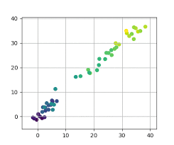
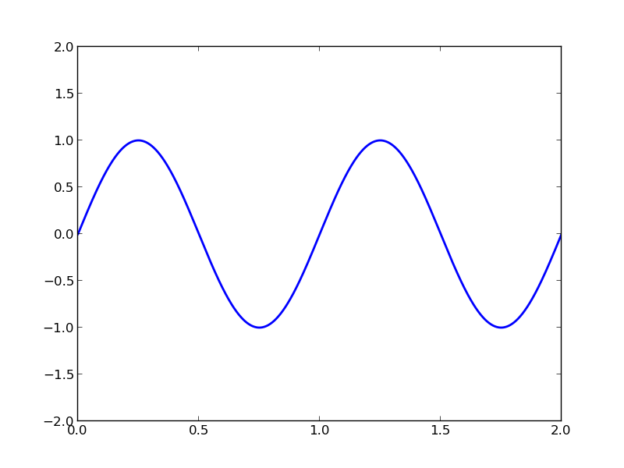
EDA with data visualization
Scatter Graphs being drawn :
Flight Number VS Payload Mass
Flight Number VS launch Site
Payload VS Launch Site
Orbit VS Flight Number
Orbit VS Orbit type
Orbit VS Payload Mass
Scatter plot shows how much one variable is effected another variable.
The relation between two variables is called their correlation.
EDA with data visualization note book : click here
Bar Graph being drawn :
Mean VS Orbit
A Bar graph makes it easy to compare sets of data between different groups at a glance. The graph represents categories on axis and discrete values in another
Line Graph being drawn :
Success Rate VS Year
A line graphs are useful in that they shows data variables and trends very clearly and can help to make predictions about the results of the data not yet recorded

Slide 11
EDA with SQL jupyter Notebook : click here
Performed SQL queries :
Displaying the names of the unique launch sites in the space mission
Displaying 5 records where launch sites begin with the string ‘CCA‘
Displaying the total payload mass carried by boosters launched by NASA (CRS)
Displaying average payload mass carried by booster version F9 v1.1
Listing the date when the first successful landing outcome in ground pad was achieved
Listing the names of the boosters which have success in drone ship and have payload mass greater than 4000 but less than 6000
Listing the total number of successful and failure mission outcomes
Listing the names of the booster versions which have carried the maximum payload mass
Listing the failed landing outcomes in drone ship, their booster versions and launch site names for the months in year 2015
Ranking the count of landing outcomes (such as Failure (drone ship) or Success (ground pad)) between the date2010-06-04 and 2017-03-20 in descending order

Slide 12
Build an interactive map with Folium
Markers of all Launch Sites:
Added Marker with Circle, Popup Label and Text Label of NASA Johnson Space Center using its latitude and longitude coordinates as a start location.
Added Markers with Circle, Popup Label and Text Label of all Launch Sites using their latitude and longitude coordinates to show their geographical locations and proximity to Equator and coasts.
Coloured Markers of the launch outcomes for each Launch Site:
-Added coloured Markers of success (Green) and failed (Red) launches using Marker Cluster to identify which launch sites have relatively high success rates.
Distances between a Launch Site to its proximities:
Added coloured Lines to show distances between the Launch Site KSC LC-39A (as an example) and its proximities like Railway, Highway, Coastline and Closest City.
jupyter NoteBook : click here

Slide 13
Build a Dashboard with Plotly Dash
Launch Sites Dropdown List:
- Added a dropdown list to enable Launch Site selection.
Pie Chart showing Success Launches (All Sites/Certain Site):
- Added a pie chart to show the total successful launches count for all sites and the Success vs. Failed counts for the site, if a specific Launch Site was selected.
Slider of Payload Mass Range:
- Added a slider to select Payload range.
Scatter Chart of Payload Mass vs. Success Rate for the different Booster Versions:
- Added a scatter chart to show the correlation between Payload and Launch Success.
Plotly Dash : click here

Slide 14
Predictive analysis (Classification)
Building Model :
Load our data in to numpy and pandas
Transform data
Split our data in training and test dataset
Check how many test samples we have
Decide which type of machine learning algorithm we want to use
Set our parameters and algorithms to GridSearchCV
Fit our data into GridSearchCV objects and train our data
Evaluating The Model :
Check accuracy for each model
Get tuned hyperparameters for each type of algorithm
Plot confusion matrix jupyter NoteBook : click here
Improving Model :
Feature engineering
Algorithm tuning
Finding The Best Performing Classification Model :
The model with best Accuracy score wins the best performing model
In the notebook there is a dictionary of algorithms with scores at the bottom of the notebook

Slide 15
Results
Exploratory data analysis results:
Space X uses 4 different launch sites;
The first launches were done to Space X itself and NASA;
The average payload of F9 v1.1 booster is 2,928 kg;
The first success landing outcome happened in 2015 fiver year after the first launch;
Many Falcon 9 booster versions were successful at landing in drone ships having payload above the average;
Almost 100% of mission outcomes were successful;
Two booster versions failed at landing in drone ships in 2015: F9 v1.1 B1012 and F9 v1.1 B1015;
The number of landing outcomes became as better as years passed.

Slide 16
EDA with Visualization

Slide 17
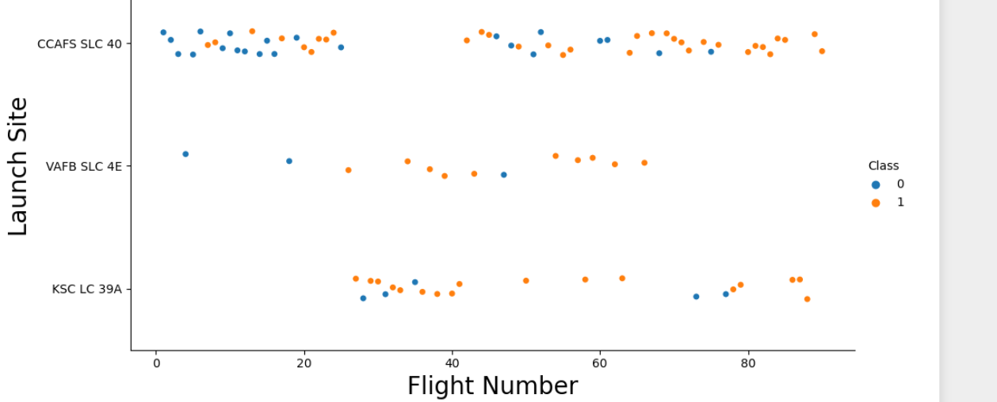
Flight Number vs. Launch Site
Explanation:
The earliest flights all failed while the latest flights all succeeded.
The CCAFS SLC 40 launch site has about a half of all launches.
VAFB SLC 4E and KSC LC 39A have higher success rates.
It can be assumed that each new launch has a higher rate of success.

Slide 18
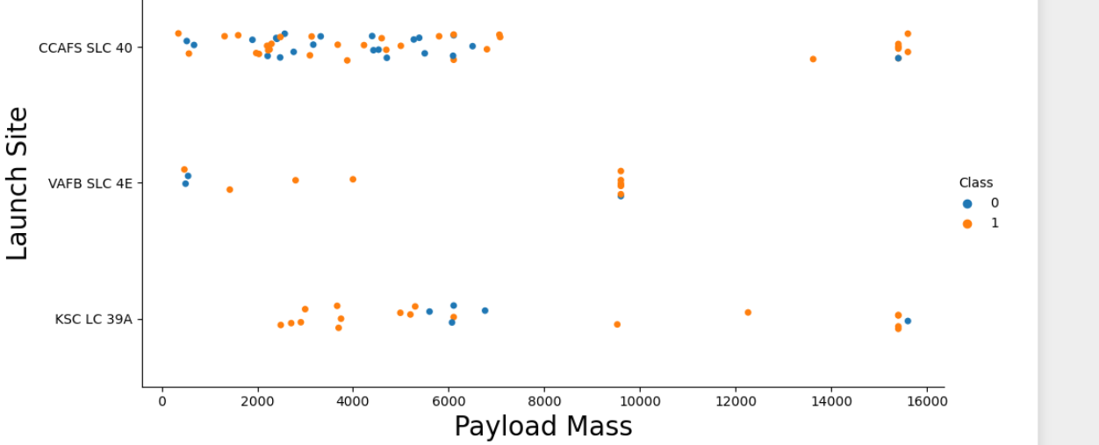
Payload vs. Launch Site
Explanation:
For every launch site the higher the payload mass, the higher the successrate.
Most of the launches with payload mass over 7000 kg were successful.
KSC LC 39A has a 100% success rate for payload mass under 5500 kg too.

Slide 19
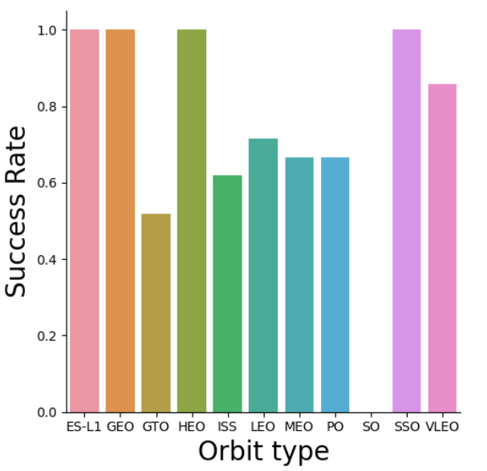
Success rate vs. Orbit type
Explanation:
Orbits with 100% success rate:-
ES-L1, GEO, HEO, SSO
Orbits with 0% success rate:
-SO
Orbits with success ratebetween 50% and 85%:
-GTO, ISS, LEO, MEO, PO

Slide 20
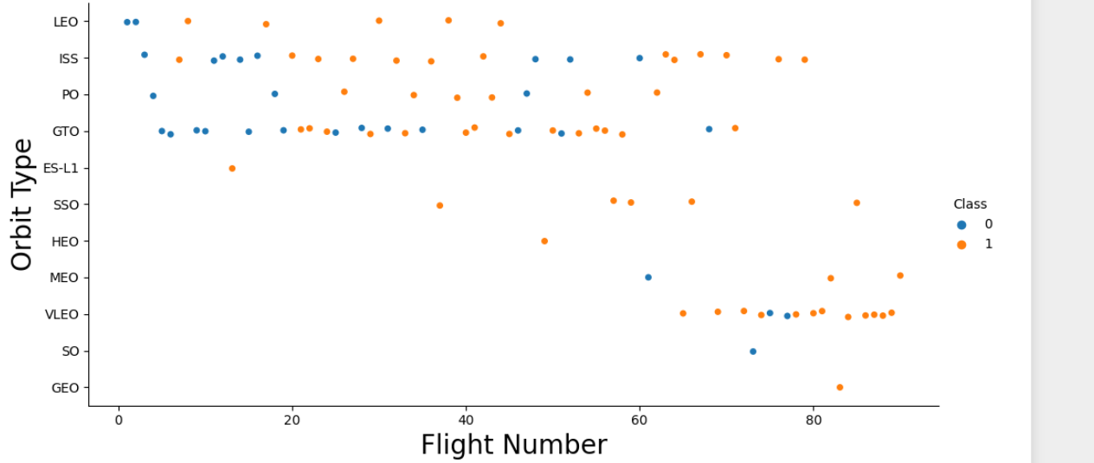
Flight Number vs. Orbit type
Explanation:
In the LEO orbit the Success appears related to the number of flights; on the other hand, there seems to be no relationship between flight number when in GTO orbit.

Slide 21
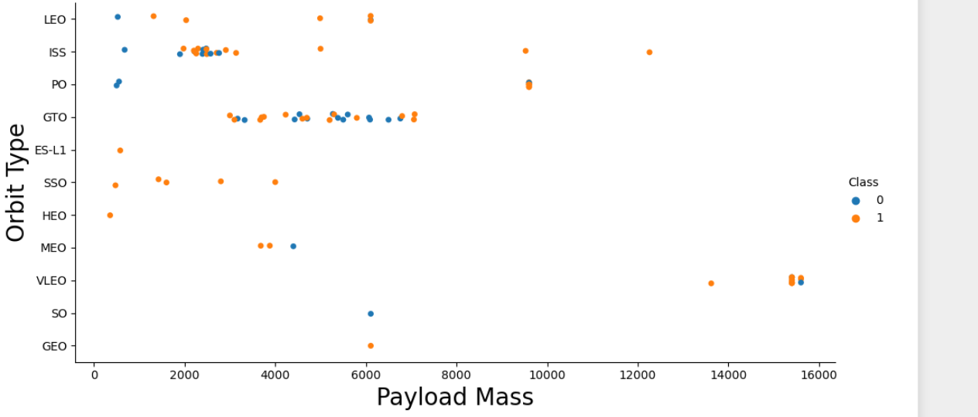
Payload Mass vs. Orbit type
Explanation:
Heavy payloads have a negative influence on GTO orbits and positive on GTO and Polar LEO (ISS) orbits.

Slide 22
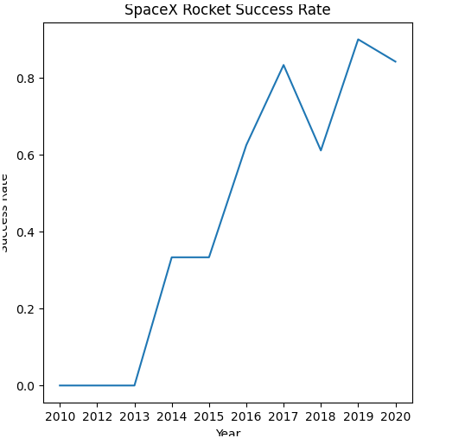
Launch success yearly trend
Explanation:
The success rate since 2013 keep increasing till 2020.

Slide 23
EDA with SQL

Slide 24
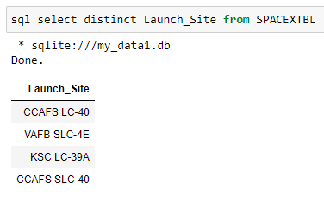
Unique launch site names
SQL QUERY
sql select distinct Launch_Site
from SPACEXTBL
QUERY EXPLANATION:
using the keyword DISTINCT in the query means it will only shows the unique values in the Launch_site column from tblSpaceX

Slide 25
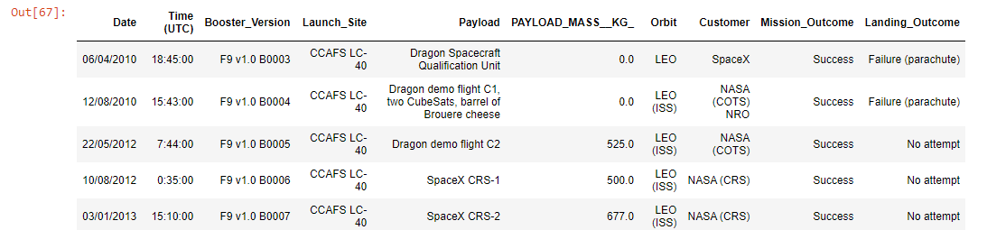
Launch site names begin with `CCA`
QUERY EXPLANATION :
using the key word means TOP5 in the query means that it will shows 5 records from the spacextbl
and like key word is a wild card with the words ‘CCA%’ the percentage symbol in the end suggests that the launch site name must starts with ‘CCA’
SQL QUERY :
sql select * from SPACEXTBL where Launch_Site like 'CCA%' limit 5

Slide 26

Total payload mass
SQL QUERY :
sql select sum(PAYLOAD_MASS__KG_) as
Total_payload from SPACEXTBL
where Customer = 'NASA (CRS)'
QUERY EXPLANATION :
Using the SUM summates the total in the column PAYLOAD_MASS__KG_
THE WHARE clause filters the data set to only perform calculations Customer_Nasa(crs)

Slide 27

Average payload mass by F9 v1.1
SQL QUERY :
sql select avg(PAYLOAD_MASS__KG_)
as Average_patload_mass from SPACEXTBL
where Booster_Version like 'F9 v1.1%'
QUERY EXPLANATION:
Using the function AVG calculate the average in the column PAYLOAD_MASS__KG_
THE WHARE clause filters the data set to only perform calculations Booster_Version 'F9 v1.1

Slide 28

First successful ground landing date
SQL QUERY :
sql select min(Date) as first_success_land
from SPACEXTBL where Landing_Outcome
like 'Success (ground pad)';
Query Explanation:
The MIN key word gives the minimum of that column
Like is a wild card key word

Slide 29
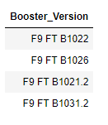
Successful drone ship landing with payload between 4000 and 6000
SQL QUERY :
sql select Booster_Version from
SPACEXTBL where Landing_Outcome
like 'Success (drone ship)' and
PAYLOAD_MASS__KG_ between 4000 and 6000
QUERY EXPLANATION:
Selecting only selects the booster version
THE WHARE clause filters the data set to only perform calculations based on two statements
the AND clause specifies(apply filter) the true when both conditions are true

Slide 30
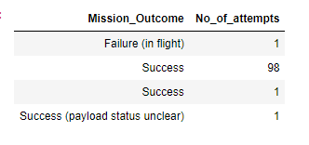
Total number of successful and failure mission outcomes
SQL QUERY :
sql select Mission_Outcome,
count(Mission_Outcome) as No_of_attempts
from SPACEXTBL group by Mission_Outcome;
QUERY EXPLANATION:
Count Key word count the specific variable based on the condition and it give how many times it is repeated
As key word acts as a alias

Slide 31
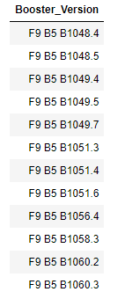
Boosters carried maximum payload
SQL QUERY :
sql select Booster_Version from SPACEXTBL
where PAYLOAD_MASS__KG_ = (select max(PAYLOAD_MASS__KG_)
from SPACEXTBL) order by Booster_Version
QUERY EXPLANATION:
Here we using sub query to compare max payload mas from PAYLOAD_MASS__KG_
Based on the max payload mass
Select booster versions which have a max payload mass

Slide 32

2015 launch records
SQL QUERY :
sql select substr(Date,4,2) as Date,
Landing_Outcome, Booster_Version,Launch_Site
from SPACEXTBL where Landing_Outcome
like 'Failure (drone ship)' and
(substr(Date,7,4) = '2015')
QUERY EXPLANATION:
SUBSTR key word takes the some part of string from a string
Using substr we take year from the total date
Here WHERE clause takes two statements

Slide 33
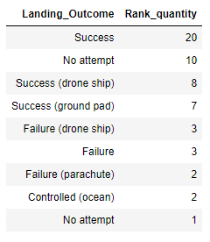
Rank success count between 2010-06-04 and 2017-03-20
SQL QUERY :
sql select Landing_Outcome,
count(*)as Rank_quantity from SPACEXTBL
where Date between '04-06-2010' and '20-03-2017‘
group by Landing_Outcome
order by Rank_quantity desc
QUERY EXPLANATION:
Using GROUP BY we combine same type of data in to one group
An ORDER BY Gives the data in a ascending order by default
COUNT counts the variable how many no of times its repeated

Slide 34
Interactive map with Folium

Slide 35
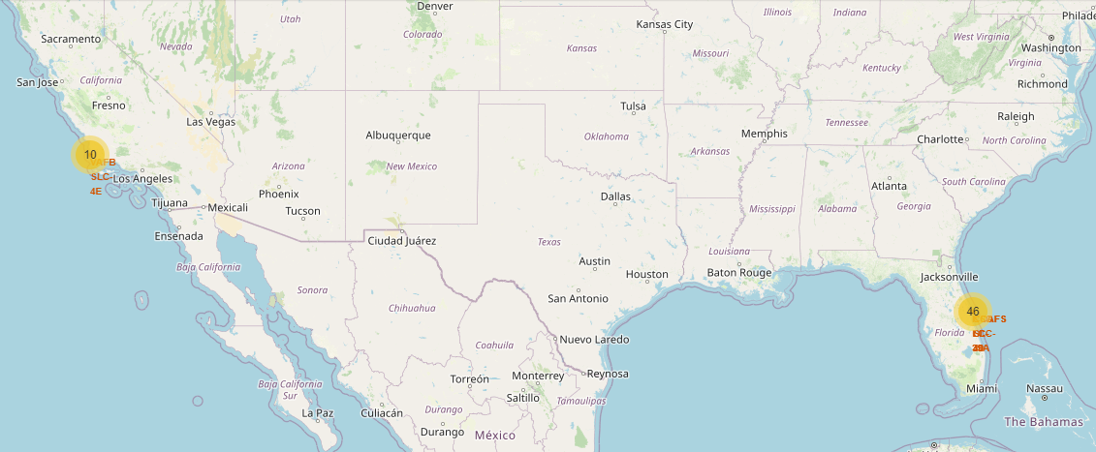
All launch sites’ location markers on a global map
Explanation:
•Most of Launch sites are in proximity to the Equator line. The land is moving faster at the equator than any other place on the surface of the Earth. Anything on the surface of the Earth at the equator is already moving at 1670 km/hour. If a ship is launched from the equator it goes up into space, and it is also moving around the Earth at the same speed it was moving before launching. This is because of inertia. This speed will help the spacecraft keep up a good enough speed to stay in orbit.
•All launch sites are in very close proximity to the coast, while launching rockets towards the ocean it minimizes the risk of having any debris dropping or exploding near people.

Slide 36
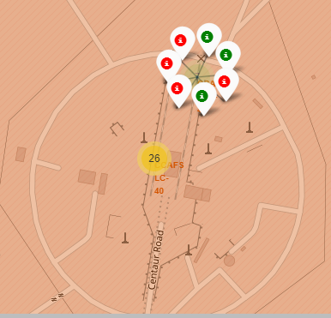
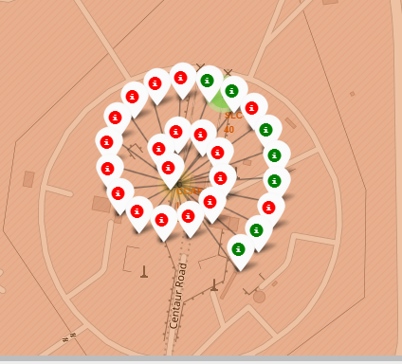
Colour-labeled launch records on the map
Explanation:
•From the colour-labeled markers we should be able to easily identify which launch sites have relatively high success rates.
-Green Marker = Successful Launch
-Red Marker = Failed Launch
•Launch Site KSC LC-39A has a very high Success Rate.

Slide 37
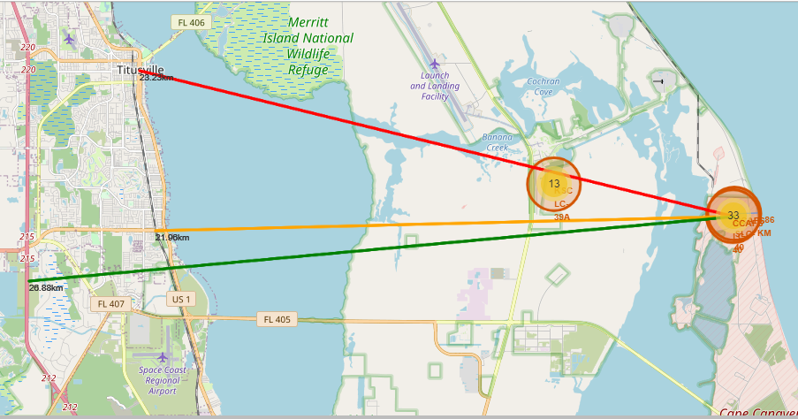
Distance from the launch site CCAFS SCL 40 to its proximities
Explanation:
•From the visual analysis of the launch site CCAFS SCL 40 we can clearly see that it is:
-relative close to railway (21.96 km)
-relative close to highway (26.88 km)
-relative close to coastline (0.86 km)
•Also the launch site CCAFS SCL 40 is relative close to its closest city Titusville (23.2 km).
•Failed rocket with its high speed can cover distances like 15-20 km in few seconds. It could be potentially dangerous to populated areas.

Slide 38
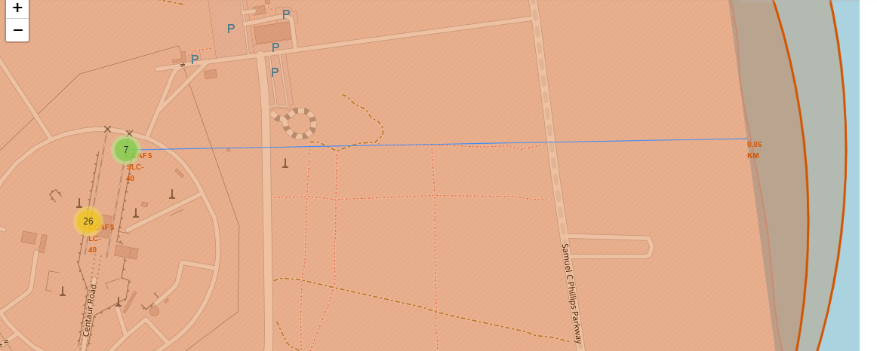
a PolyLine between a launch site to the selected coastline point
the costal line distance from CCAFS SCL 40 is 0.86 is nearly ~ 0.9

Slide 39
Build a Dashboard with Plotly Dash

Slide 40
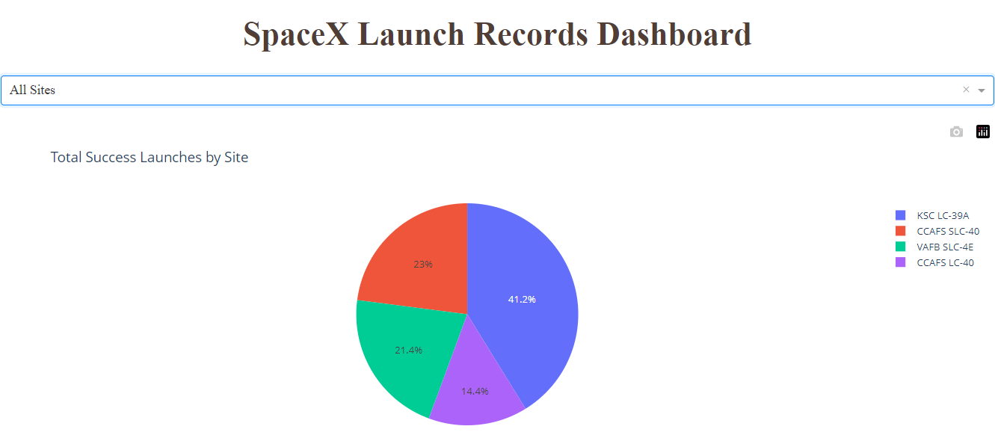
Launch success count for all sites
EXPLANATION:
The chart clearly shows that from all the sites, KSC LC-39A has the most successful launches.

Slide 41
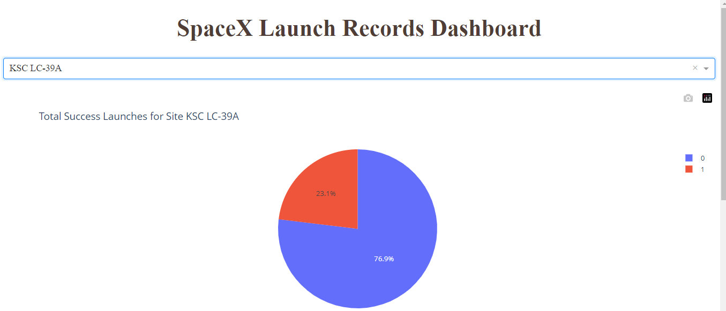
Launch site with highest launch success ratio
EXPLANATION:
using the keyword DISTINCT in the query means it will only shows the unique values in KSC LC-39A has the highest launch success rate (76.9%) with 10 successful and only 3 failed landings.

Slide 42
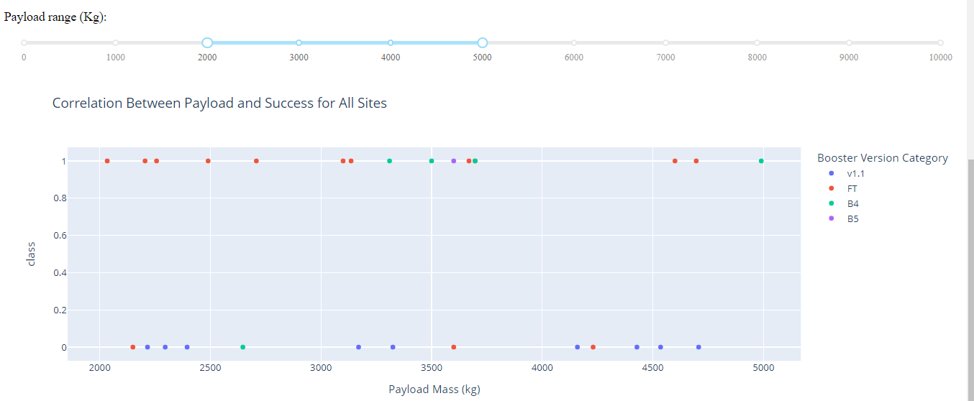
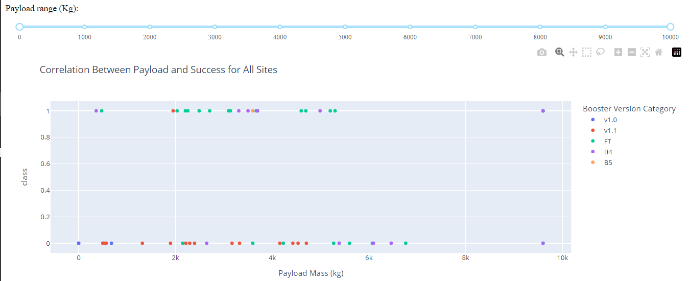
Payload Mass vs. Launch Outcome for all sites
Explanation:
The charts show that
payloads between 2000
and 5500 kg have the
highest success rate.

Slide 43
Predictive analysis
(Classification)

Slide 44
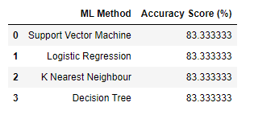
Classification Accuracy
Accuracy Classification Using Training Data:
As we can see our Accuracy is
extremely close all the models have
a same accuracy on test data set is 83.33%
it should be noted the size of the sample
is small at only sample size of 18

Slide 45
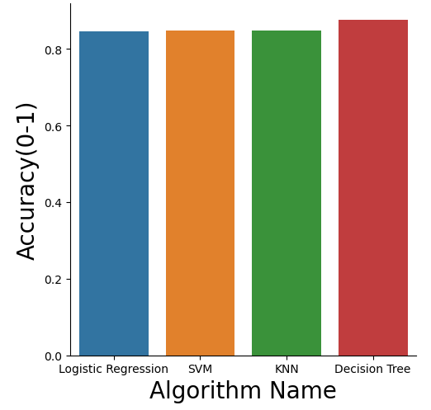
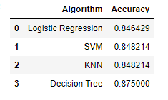
Classification Accuracy
Accuracy Classification Using Training Data:
here we see that we show the data based on
the best_score we see the small difference and
got the solution
Here we see that decision tree do the best
performance

Slide 46
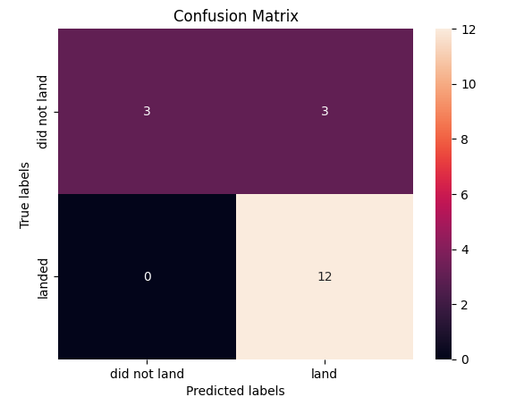
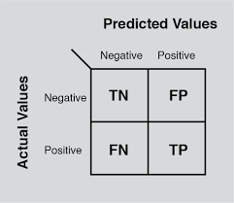
Confusion Matrix
EXPLANATION:
Examining the confusion matrix, we see that logistic regression can distinguish between the different classes. We see that the major problem is false positives.

Slide 47

CONCLUSION
Decision Tree Model is the best algorithm for this dataset.
Launches with a low payload mass show better results than launches with a larger payload mass.
Most of launch sites are in proximity to the Equator line and all the sites are in very close proximity to the coast.
The success rate of launches increases over the years.
KSC LC-39A has the highest success rate of the launches from all the sites.
Orbits ES-L1, GEO, HEO and SSO have 100% success rate.

Slide 48

APPENDIX
Special thanks to
Instructors:
Rav Ahuja, Alex Aklson, Aije Egwaikhide, Svetlana Levitan, Romeo Kienzler, Polong Lin, Joseph Santarcangelo, Azim Hirjani, Hima Vasudevan, Saishruthi Swaminathan, Saeed Aghabozorgi, Yan Luo
Coursera
IBM

